Slide 1
My Story of the Game
By Nischal Kalahasti

Slide 2
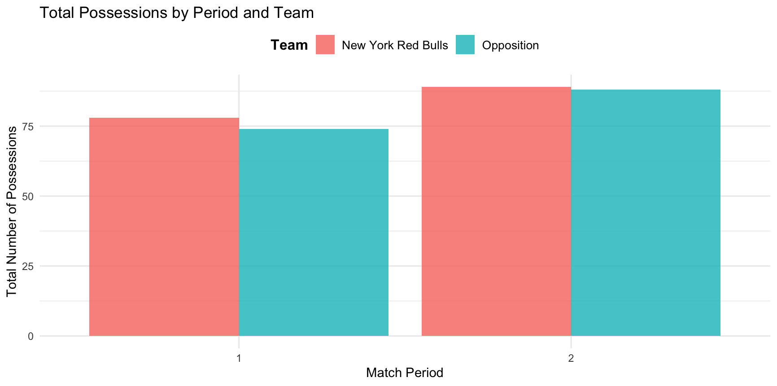
Possession Analysis
Possessions: I first analyze which team had more possessions during the two periods of the game.
Throughout the match, the New York Red Bulls had slightly more possessions in each period in this game against the opposing team.
This is advantageous as they could have more opportunities to score

Slide 3
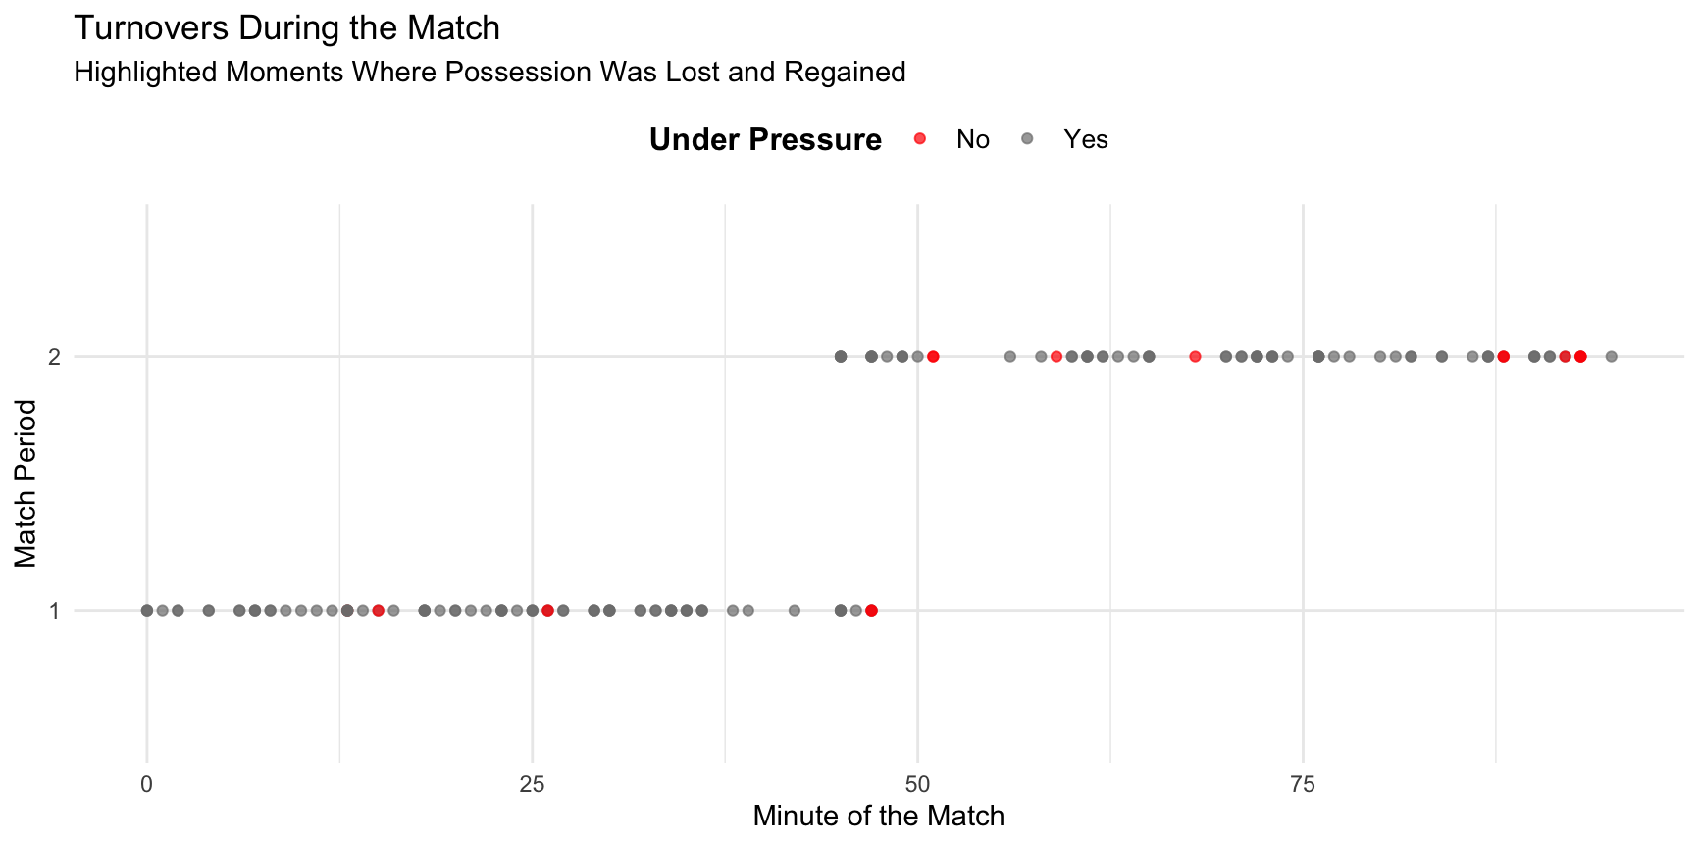
Turnovers
Turnovers: I highlight moments where possession was lost and regained, especially under pressure.
The teams were under pressure for the majority of the match, and due to this there were turnovers.
We can say that stakes seemed high as teams were playing press coverage a lot.

Slide 4
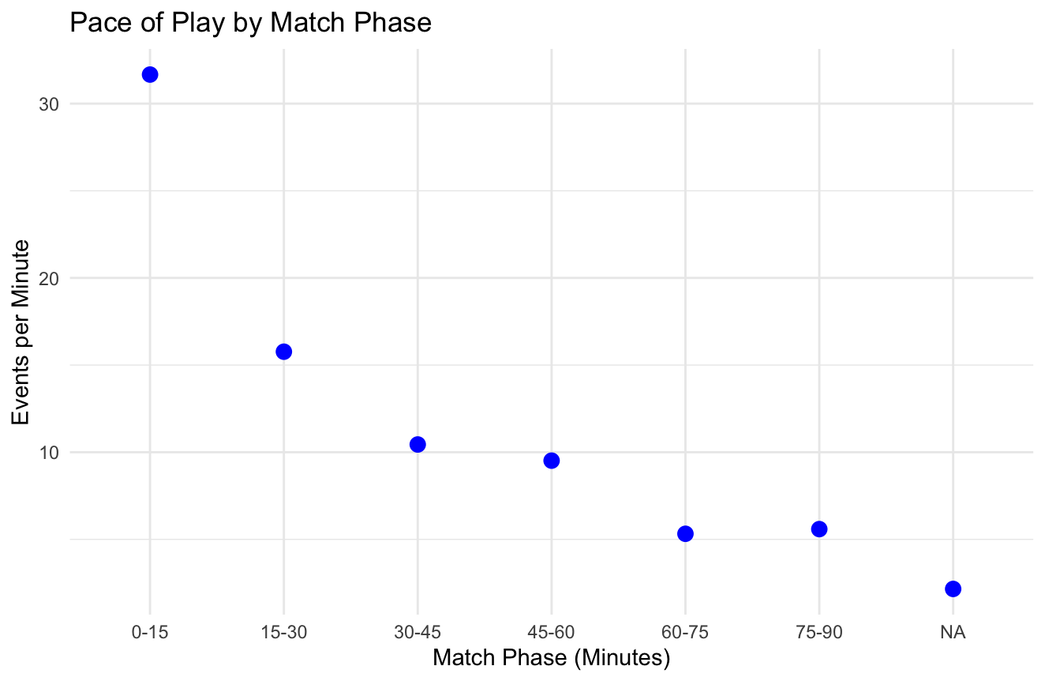
Tempo and Rhythm
With the pace of play, I assessed how the tempo of the game changed during different phases and how it affected the overall play.
The game seems to start with high tempo, with high count of events per minute during the first 15 minutes as the player’s energy levels are high.
As the game starts to progress, the tempo then appears to slow down during the 15-45 minute phase, where we notice a decrease in the events per minute with the players getting more fatigued but also zoned in.
In the latter stages, particularly from 60-75 minutes onwards, there is a very low count of events due to strategic adjustments or a need to push for a result.
-

Slide 5
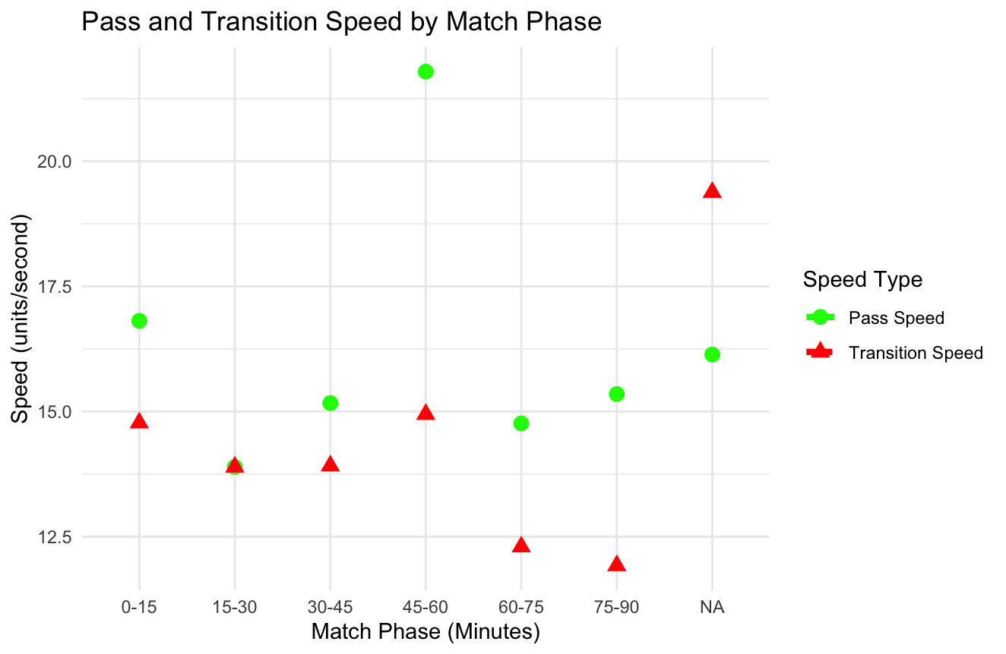
Tempo and Rhythm (cont.)
- With the pass speed and transition speed, I am able to analyze how quickly the ball was moved up the field during transitions.
- Similar to pace of play, the game begins with high rhythm, with high pass and transition speeds during the first 15 minutes.
- As we saw in pace of play also, the rhythm then appears to slow down during the 15-45 minute phase, where both pass and transition speeds decrease.
- However, particularly from 60-75 minutes, there is a recovery in pass speed, indicating a possible increase in tempo as the game progressed, perhaps due to strategic adjustments or a need to push for a result.

Slide 6
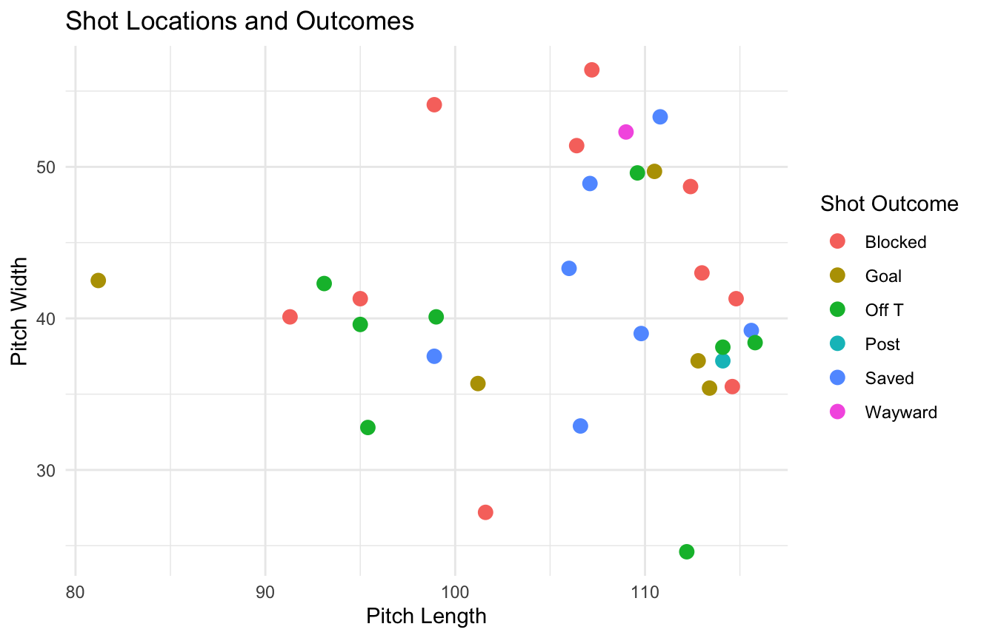
Shot Locations and Outcomes
The number of shots and their outcomes (goal, on target, off target) provide insight into the team's finishing efficiency and the quality of chances created.
As the players got closer to the goals posts, a lot more events took place.
Many were either saved or blocked.

Slide 7
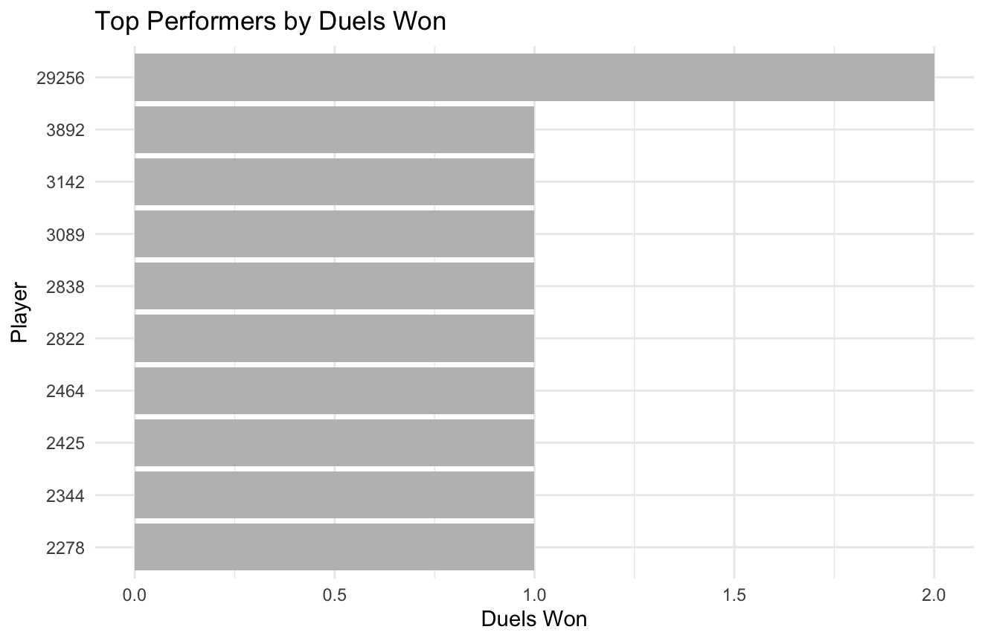
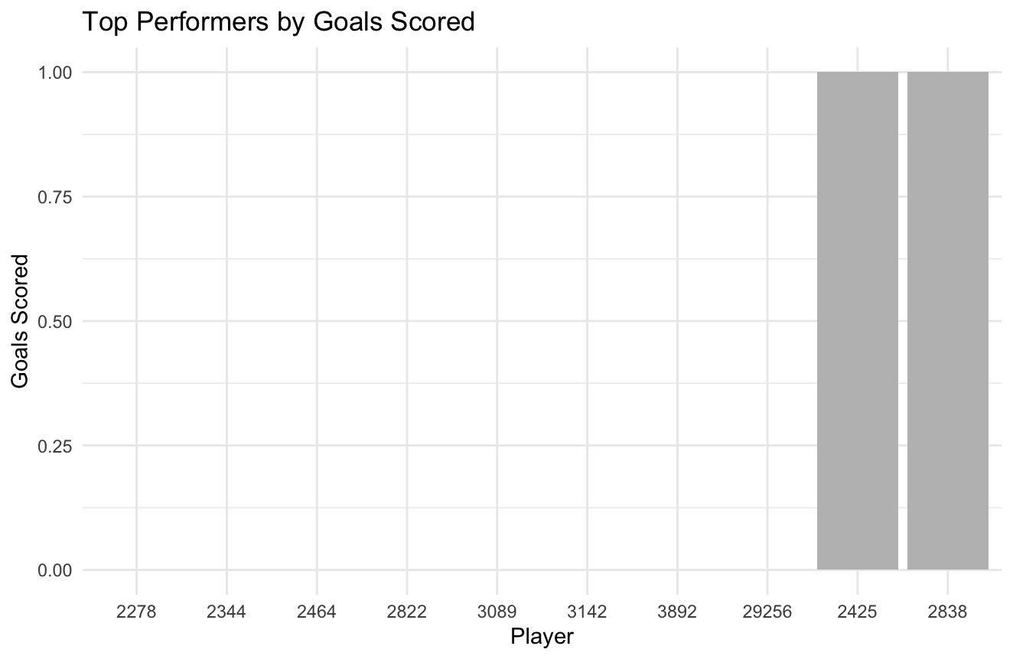
Player Contributions
Individual Player Analysis: I showed standout performances, such as a player who consistently won duels or scored.
- Player 29256 won two duels, while the rest won one of them.
- In terms of the top performers, Player 2425 and 2838 were pivotal for their teams as they each scored 1 goal apiece.

Slide 8
Conclusion
The New York Red Bulls were able to win this game on sheer ball control with high possession count as well as stepping up when it matters most.
The match was characterized by a strong start from the team, with high tempo and aggressive play, particularly in transitions. However, as the game wore on, the pace slowed, and the team faced increased resistance from the opponent, who adapted their defensive strategy effectively. Key players made significant contributions, particularly in the early and late stages of the match. Substitutions had mixed impacts, highlighting the delicate balance of maintaining momentum while introducing fresh legs.
In summary, the game demonstrated the team's ability to dominate early on but also revealed challenges in sustaining that intensity across the full 90 minutes. The opponent's adjustments, particularly in defense, played a critical role in the match's outcome, suggesting areas for strategic refinement in future games, especially in maintaining tempo and effectiveness in the middle phases of play.

